Slide 1
Economic update
30 June 2020
for Blusource Recruitment
Rosie Smith, Regional Agent
East Midlands Agency

Slide 2
Recent data on the UK economy
 | Latest data | Expected Q2 / end June
Gross Domestic Product | March -6% April -20% | Q2 probably less negative than minus -25% feared in March
Unemployment | End March 3.9% End April 3.9% | Risk of high & persistent unemployment, perhaps up to 9% in next few months
CPI Inflation | March 1.5% April 0.8% May 0.5% | June around 0.5%

Slide 3
Covid-19 is expected to have a large impact on firms’ sales, employment and investment over the next year
Notes:
(a) The results are based on the questions ‘Relative to what would otherwise have happened, what is your best estimate for the impact of the spread of coronavirus (Covid-19) on the sales, employment and capital expenditure of your business in each of the following periods?’ Respondents provided their expected impacts for 2020 Q2, 2020 Q3, 2020 Q4 and 2021 Q1.

Slide 4
Largest sales impacts in 2020 Q2 are expected in highly consumer-facing services
Notes:
(a) See footnote for Chart 1.

Slide 5
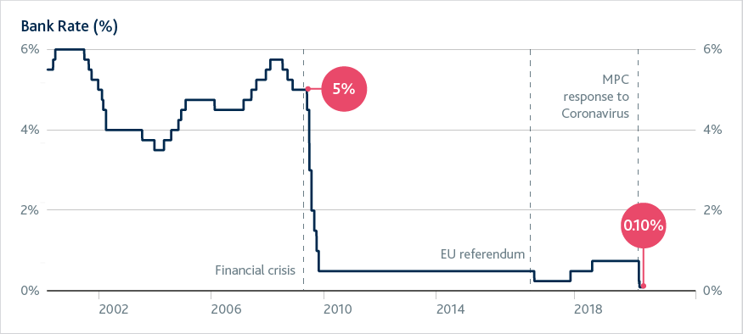
Bank of England policy actions
also
Term Funding Scheme – with additional incentives for SME lending
Countercyclical buffer for banks reduced from 1% to 0%
Covid Corporate Financing Facility (CCFF)
Increase of £200bn in asset purchases to £645bn announced March
Increase of £100bn in asset purchases to £745bn announced June

Slide 6
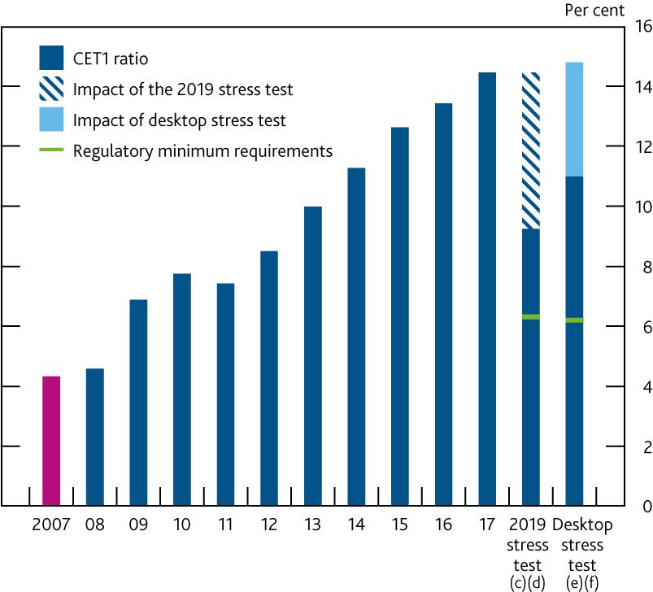
Banks’ capital positions were over three times higher than their pre-global financial crisis levels
Aggregate CET1 capital ratio of major UK banks since the financial crisis^{(a)(b)}
Sources: Participating banks’ Stress Testing Data Framework data submissions, PRA regulatory returns, published accounts, Bank analysis and calculations.:
Notes:
The CET1 capital ratio is defined as CET1 capital expressed as a percentage of risk-weighted assets. Major UK banks are Barclays, HSBC, Lloyds Banking Group, Nationwide, The Royal Bank of Scotland, Santander UK and Standard Chartered. From 2011, data are CET1 capital ratios as reported by banks. Prior to 2011, data are Bank estimates of banks’ CET1 ratios.
Capital figures are year-end.
The impact of the 2019 stress test does not include the conversion of AT1 instruments.
The 2019 stress test capital drawdown starts from 2018 Q4.
The desktop stress test capital drawdown starts from 2019 Q4.
The risk-weighted minimum requirements in the desktop stress test are based on setting P2A as a nominal amount, in line with the ‘PRA statement on temporarily setting P2A as a nominal amount from 7 May 2020’. In this exercise the nominal value of P2A requirements is assumed to remain constant over the horizon.

Slide 7
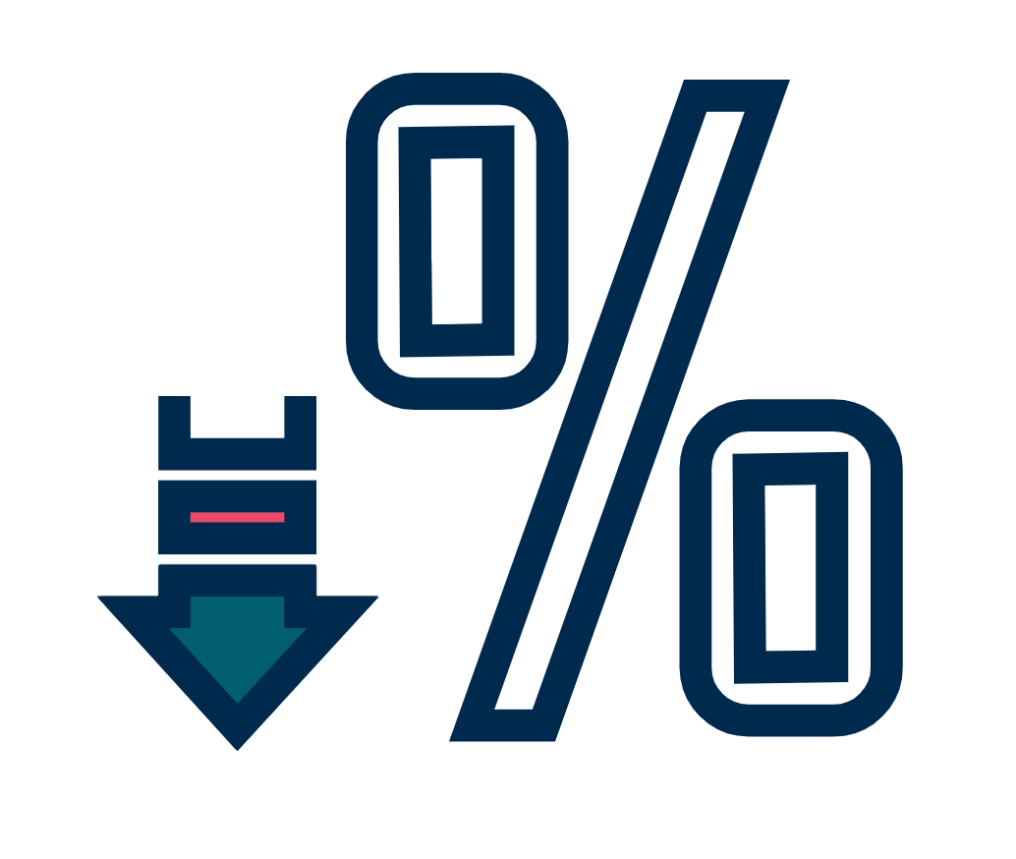
Covid-19 is dramatically reducing jobs and incomes in the UK
We are supporting households and businesses, by keeping interest rates low…
…and helping banks to expand lending.
This will help the economy recover and keep the financial system safe and stable

